Slide 1
JWOOD RAW ES
Information Night 5/24/23
Jonna AuCoin, Principal

Slide 2
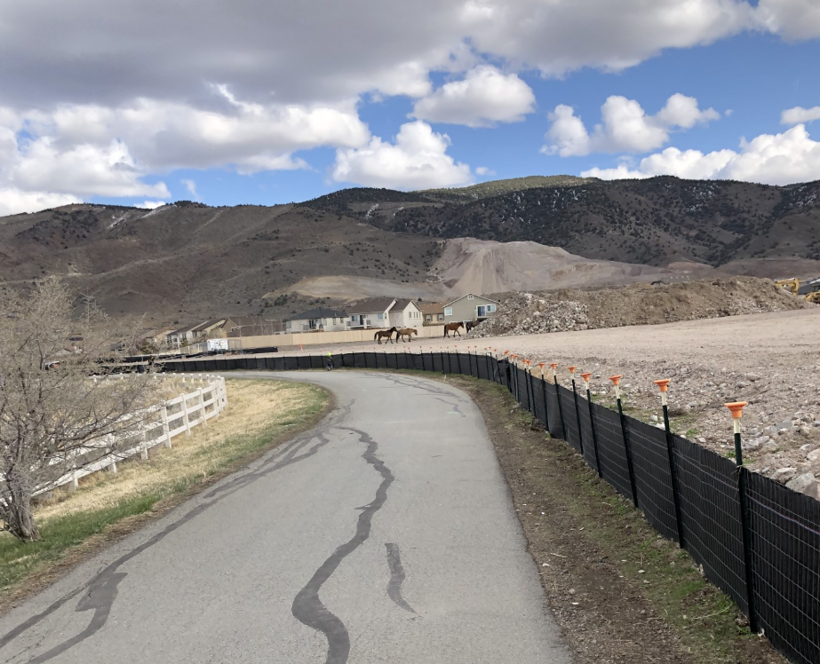
2020 – Future JWood Raw ES Site

Slide 3
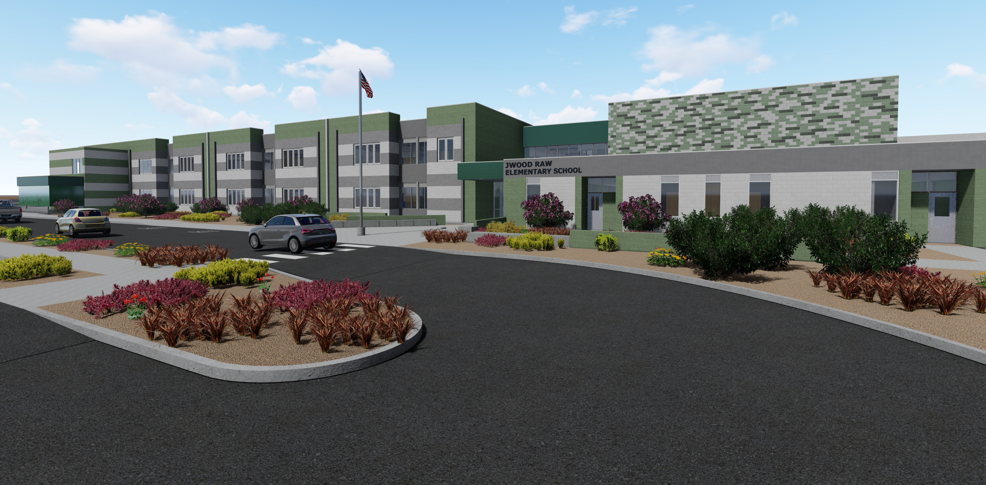
Home of the JWood Jags! - Fall 2023

Slide 4
Information Night Agenda
Introductions
Who was Mr. JWood Raw?
Logistics/Procedures
Curriculum & what makes JWood Raw ES unique? Partner in Ed
Sierra Kids-Before and After School Care
How to get involved & PTO
Q and A

Slide 5
Our JWood Raw Dream Team
42 Staff from 23 schools
Over 600 years of experience
Projected: 515 students
Dean of Students
School Psychologist
Counselor
Administrative Secretary
IEC, EC Strategies, Strategies
K = 3 teachers
1 = 4 teachers
2 = 5 teachers
3 = 5 teachers
4 = 3 teachers
5 = 3 teachers
Resource = 2
SLP = 1
Music = 1
Librarian 35 hours and ETS = 27 hours

Slide 6
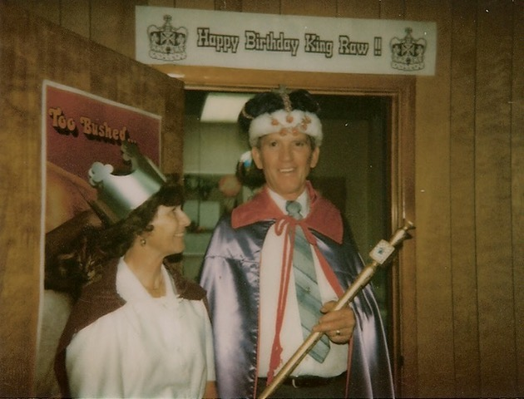
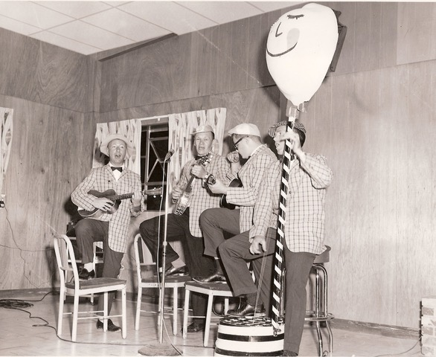
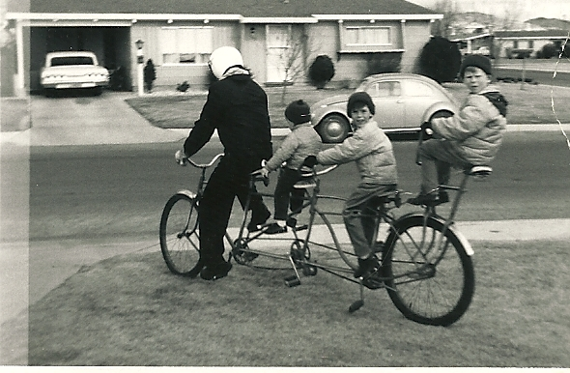
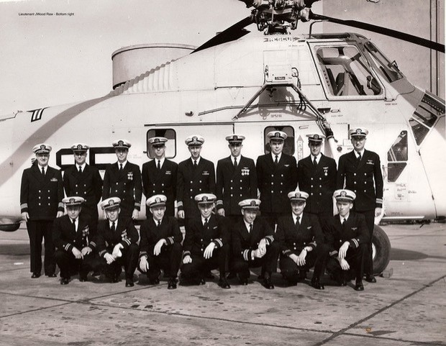
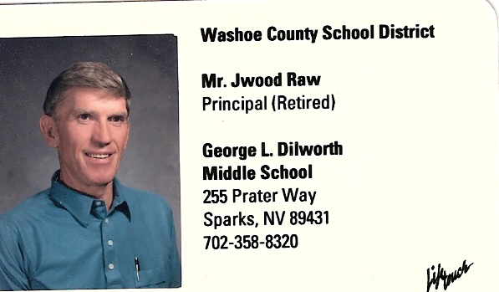
Mr. JWood Raw
Husband and Father
Three sons and grand children who will attend JWood Raw ES
Naval Aviator
WWII
Community Member
Founding member of Junior Ski Program
Educator
Shop Teacher, AP, Principal
Member of a String Quartet
Notes:
Get stats how long married
How long in Navy (our colors)
Started Junior Ski Program at…..mountain
Shops teacher, AP and Principal how many years in educ…roller skates story

Slide 7
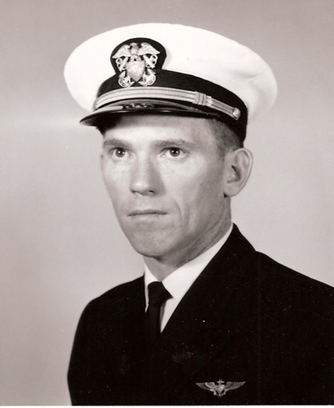
Our School Colors are
Navy and Gold
To honor & recognize Mr. Raw’s service in the Navy

Slide 8
Logistics and Procedures
8:45 M-F Soft Opening
Tardy Bell at 9:00 am
8:45 – 3:00 Mon, Tues, Thurs, Fri
8:45 –2:15 Wednesdays
Free breakfast and lunch 23-24
Before and After Care
City of Reno
Pick up & Drop Off
Walkers
Kiss and Drop
Bikes/Scooters
Bus Students
Safety Precautions
Single Point Entry
Drills
Locked Doors

Slide 9
JWOOD RAW ELEMENTARY SCHOOL
One Way
Green
Pasture
Drive
Stepping
Stone
Traffic coming from both directions
Rio Wrangler
Right Turn Only
Rio Wrangler

Slide 10
Instructional Commitments and Partners in Education
Social and Emotional Learning
Aviation
Project Lead the Way
Standards Based Grading & Report Cards
Level 1-4
Partners in Education
Great Basin Aviation
FOSS Integration
Eliminates letter grades
Pathway to Aviation
Robotics
Core Curriculum
ELA – Benchmark
Math – Bridges/EnVision
Science – Foss
Social Studies – Scott Foresman
Focus on mastery
Growth Mindset
We rely on standards, rather than curriculum and core academic areas are integrated throughout each day

Slide 11
Traditional Grades VS. Standards Based
Focus is on a cumulative grade
Focuses on Growth to Mastery
Can be arbitrary
Effort,
Teacher philosophy
a 73% or an 85%?
Number of problems vs. mastery of problems
Average of 9 weeks, starts cycle over,
One low grade can have major consequences
Level 1 – Below Standard
Level 2 – Approaching Standard
Level 3 – At Standard
Level 4 – Above Standard
Continued learning is the expectation
Allows students ownership, deeper understanding a clear path to mastery

Slide 13
JWood Raw is implementing a technology rich program. This means rather than 1:1, we are 80%.
Students in grades K-1 will have iPads and students in grades 2-5 will have laptops.
Students will still use paper/pencil for learning as well because technology does not replace the basics of learning in the classroom.

Slide 14
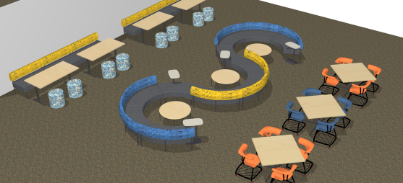
3 Learning Hub Spaces

Slide 15
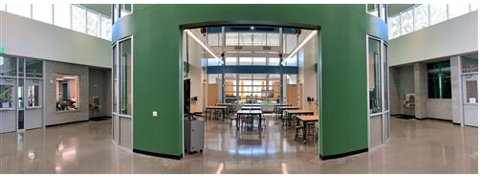
STEAM Lab (w/ Kiln) and Makerspace (Robotics, Computer Science, Aviation, Legos)
2 Learning Studios
3 Hub Spaces (Flex seating, Charging Stations, Café Tables)
4 Small Group Rooms
Media Center (Library)
PTO Kitchen & Community Room
2 Conference Rooms

Slide 16
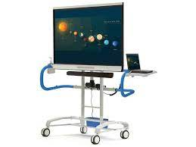
Classroom Technology
75 inch Promethean Active Panels
55 inch flat screen monitors
(AirTame for student “mirroring”)
Audio Enhancement System
Educam Classroom

Slide 17
Before/After School Care
• City of Reno Sierra Kids
• Program will begin Monday, August 14th
• Hours:7:00 AM to 9:00 AM & 3:00 PM to 6:00 PM
• Registration will be on the City of Reno website as well as the JWood Raw website.
775.393.4171

Slide 18
Volunteer Opportunities & Job Opportunities
Pilots!!
Share your gifts!
Help with traffic
Help in the classroom
Help with duties
Help in the office
Help with prepping materials
Etc. etc. etc.
35 Hour Assistant
Night Custodian
3 one on one aides
EC Strategies Teacher
PE?
Art?

Slide 19
Joe Cervantes
Account Manager
c: 775.690.9582
thesourcinggroup.com

Slide 20
JWood Raw PTO
• Supports curriculum, instruction and school-wide needs
• Meets every month – 2nd Tuesday @ 5:30
• Coordinates and Conducts School-Wide Fundraisers
• Please scan the QR code and complete the form if interested in being involved in PTO.

Slide 21
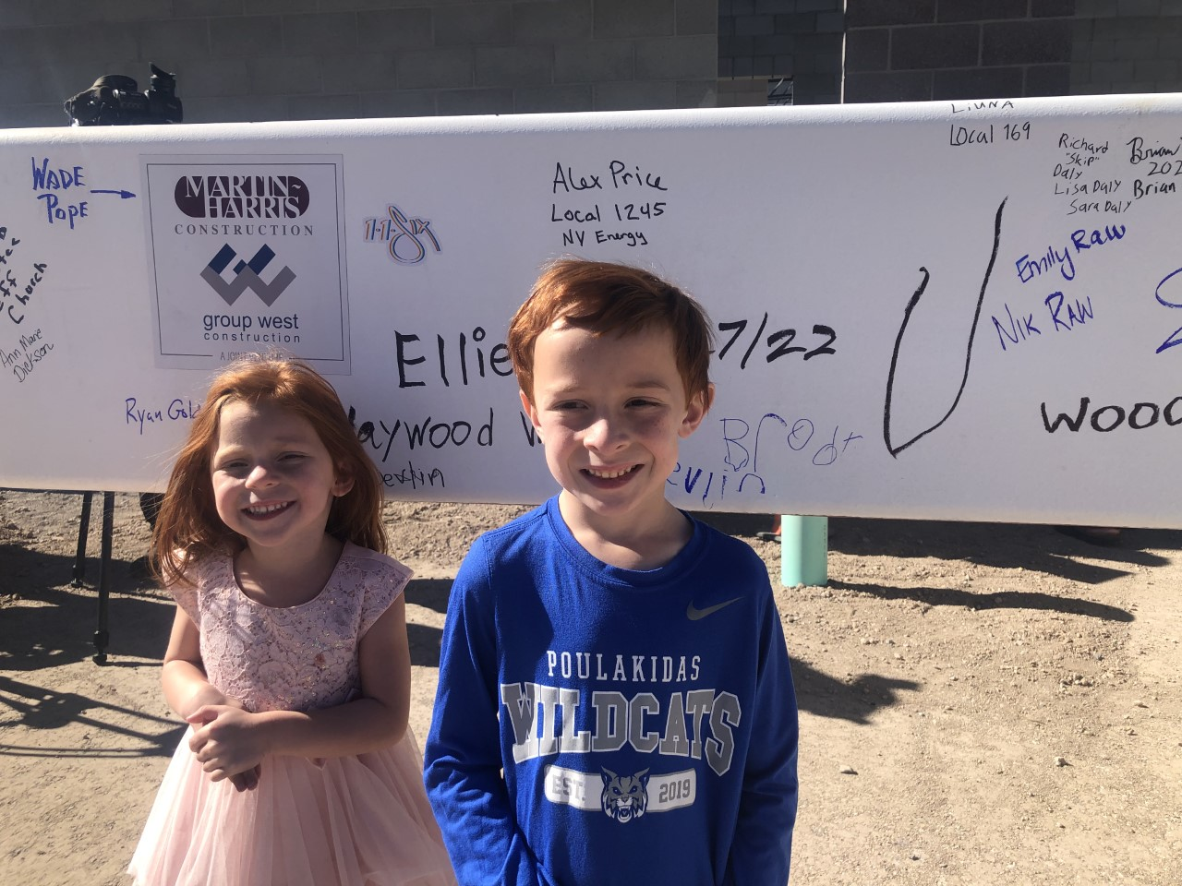
Our Why!
Thank you and any
Questions?
jaucoin@washoeschools.net
clcook@washoeschools.net

